Slide 1
RESTRICTIVE PRACTICE Reducing and Eliminating Restrictive Practices Ethical, legal and practical issues Do the right thing and be seen to do it!

Slide 2
Acknowledgement of Country
We would like to respectfully acknowledge the Traditional Custodians of the land on which we meet, and pay our respects to Elders past, present and emerging.

Slide 3
Introduction | Purpose of the Presentation Background

Slide 4
Aims of the Presentation
Explore the balance between freedom and restriction
Enhance the safety and well being of students
Understand and answer some of the issues arising regarding restrictive practice and restraint
Increase competence and confidence in the area of restriction
Generate specific issues and questions to share with relevant people

Slide 5
Session 1 | Behaviours is all forms of communication Architecture of the Brain, Dan Siegel Why students’ behaviour the way they do Communication Challenging Behaviours

Slide 6
Dr Daniel Siegel presenting a Hand Model of the Brain - Bing video
Notes:
NOTE: To change images on this slide, select a picture and delete it. Then click the Insert Picture icon in the placeholder to insert your own image.

Slide 7
Behaviour we see
What is the actual Behaviour

Slide 8
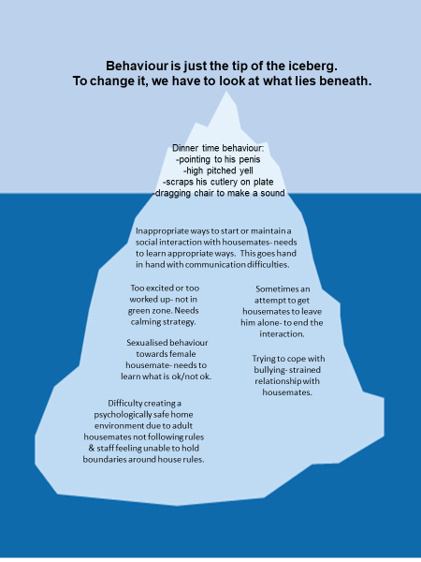

Slide 9
Session 2 | Restrictive Practises Define the 5 types What are they, what are their purpose? Principle Guiding the use of Restrictive Practises Interactive decision-making reporting tree tool

Slide 10
Definition

Slide 11
Types of Restrictive Practice
Physical restraint/intervention
Seclusion/withdrawal
Chemical intervention/restraint
Mechanical
Environmental
Notes:
Taken it wider than just Physical Intervention and restraint. Majority of students will not need any PI but can still be restricted above and below the radar.

Slide 12
Children & Young People Decision Trees
https://www.ndiscommission.gov.au/document/2741
Interactive decision tree
* What constitutes a RRP with children and young people with disability
* Reporting requirements

Slide 13
Session 3 | Situation and examples How do you know if it is a Restrictive Practise? Function of Behaviour Focus on Behaviour

Slide 14
Restriction…
You see a person in the enclosed back garden with a member of staff standing close to the door in to the house. The person in question is showing some signs of distress.
Is it restrictive?
What more do you need to know?
What makes it more/less restrictive?

Slide 15
The Problem
What is the problem?
Blocking the door
Who has this problem?
The person becoming distress
Why should this problem be solved?
Restrictive Practices??
How will I know this problem has been solved?
Least harm

Slide 16
Restriction…
You notice in the daily report that a student has not gone out on a planned trip due to his ‘inappropriate’ behaviour.
Is this restrictive?
What more do you need to know?
What makes it more/less restrictive?

Slide 17
The Problem
What is the problem?
Student not allowed to attend
Who has this problem?
The person not allowed to go
Why should this problem be solved?
Restrictive Practices??
How will I know this problem has been solved?
Last Resort ??

Slide 18
Restriction…
You notice in the log that a student has had 3 episodes of behaviour which required restraint.
Is this restrictive?
What more do you need to know?
What makes it more/less restrictive?

Slide 19
The Problem
What is the problem?
Student being restrained
Who has this problem?
Student and Teacher
Why should this problem be solved?
Restrictive Practices??
How will I know this problem has been solved?
Shortest time

Slide 20
Assessing Restrictive Practice

Slide 21
Session 4 | Background information Key documentation Authorisation of a Restrictive Practise The rights of the person The WHY we use it

Slide 22
Principles guiding the use of RP
LAST RESORT
Risk of harm
Least
Be used only as a last resort in response to a risk of harm to the person with disability and/or others, and after the implementing provider has explored and applied other evidence-based, person-centred and proactive strategies there.
Be the least restrictive response possible in the circumstances to ensure the safety of the person and/or others
Reduce the risk of harm to the person with disability and/or others
SHORTEST
Be used for the shortest possible time to ensure the safety of the person with disability and/or others
Be in proportion to the potential negative consequence or risk of harm
PROPORTION

Slide 23
The way to get started is to quit talking and begin doing.
Walt Disney

Slide 24
What are your next steps?
Investigate what is a Restrictive Practice
4
Talk to all parties involved
3
2
Produce solutions
1
Reflective Practices
Notes:
Notes to presenter:
What steps will you be taking as a result of this learning experience?
Did you learn from any failed experiences? How will you do things differently?
What advice will you give to others so they can learn from your experiences?
How can you share what you learned with a real-world audience?
Some examples of next steps might be:
After delivering my first persuasive presentation, I am thinking about joining the debate team.
After making my first film, I’m considering entering it in our school film festival or local film festival.
After connecting with this career expert, I’d like to do some research on that career field because it sounds interesting to me.
This SmartArt allows you add images and text to help outline your process. If a picture is worth a thousand words, then pictures and words should help you communicate this reflection on learning perfectly! You can always click on Insert>SmartArt to change this graphic or select the graphic and click on the Design contextual menu to change the colors.
Feel free to use more than one slide to share your next steps. It also helps to add some video content to explain your message.

Slide 25
Workable Solutions
Solution #1
What materials does this solution require?
What would this solution look like (drawing, pictures, text)?
Solution #2
What materials does this solution require?
What would this solution look like (drawing, pictures, text)?
Solution #3
What materials does this solution require?
What would this solution look like (drawing, pictures, text)?
What are some barriers you might come across with this solution?
What are some barriers you might come across with this solution?
What are some barriers you might come across with this solution?

Slide 26
Session 5 | Education and Training Keeping people safe Building trust Reflective

Slide 27
Your role in minimising restrictive practice
How do you know what is going on?
What safeguards are there for individuals and support staff?
What are you concerned about?

Slide 28
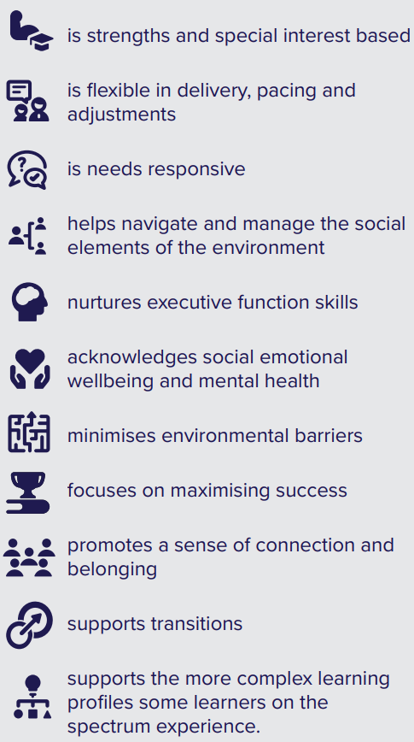
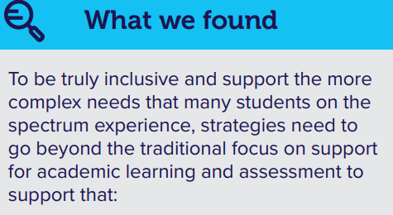
Middle Years Behaviour Support Project | Autism CRC

Slide 29
Rights
Dignity
Freedom
Choices
Risk taking

Slide 30
Session 6 | Relationship Building Supportive Decision Making Strategies

Slide 31
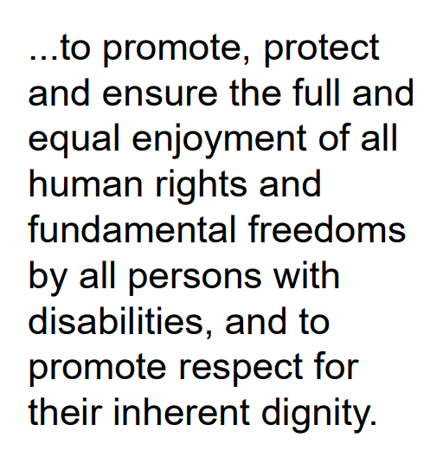
Why Regulate and Monitor?
Notes:
NOTE: To change images on this slide, select a picture and delete it. Then click the Insert Picture icon in the placeholder to insert your own image.

Slide 32
Supporting the system

Slide 33
The Mental Capacity Act 2005 set out five key principles:
• we must begin by assuming that people have capacity.
• people must be helped to make decisions if they need help.
• unwise decisions do not necessarily mean lack of capacity.
• decisions must be taken in the person’s best interests.
• decisions must be the least restrictive of freedom as is possible

Slide 34
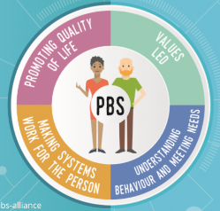
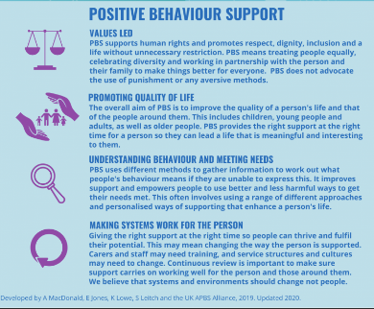
Slide 1
Systems
Teamwork
Ideas
Data
Detective
Refelective
Who supports you
Working towards a common goal
Forming strategies
Gathering information
Finding the missing link
Understanding the why
When scaling, group all elements to be scaled. Scale as needed. Use the “Increase Font Size,” “Decrease Font Size” buttons or manually change the font size for the editable text. Delete unwanted elements. Change the line weight of the circles or connecting bars as needed.

Slide 35
Supported Decision Making Principles

Slide 36
Leadership
Environments
Staff
Systems
A positive culture
Towards excellent practice
When scaling, group all elements to be scaled. Scale as needed. Use the “Increase Font Size,” “Decrease Font Size” buttons or manually change the font size for the editable text.

Slide 37
Accessibility
Staffing
Numbers
Holistic, personalised planning, involve person and family carers in decisions
Leadership
Visible, ‘present’ leadership
Environments
Comprehensible
Quality
Quality, attitudes, values, reflection, support
Skills, general and specific
Leadership at all levels
Systems
Minimal use of restrictive approaches as part of whole plan. (BILD code of practice)
Regular transparent review and reporting of arrangements
Training from accredited trainers, develop internal trainers?
Records of trained staff, check competence over time
Managers and leaders need good understanding and investment in the process.......... don’t delegate it too far down the ‘food chain?’
Lead by example........ open culture of reflection and feedback
Support for concern raising and whistleblowing
Open and outward looking

Slide 38
Conclusion | Resources References Strategies

Slide 39
Overview NDIS Regulated RP guides

Slide 40
References and Resources
Government of Western Australia, Department of Communities Authorisation of Restrictive Practices in Funded Disability Services Landing Page: https://www.wa.gov.au/organisation/department-of-communities/authorisation-of-restrictive-practices
NDIS Act 2013: https://www.legislation.gov.au/Details/C2013A00020
NDIS (Code of Conduct) Rules 2018: https://www.legislation.gov.au/Details/F2018L00629
NDIS (Provider Registration and Practice Standards) Rules 2018: https://www.legislation.gov.au/Details/F2018L00631
NDIS (Restrictive Practices and Behaviour Support) Rules 2018: https://www.legislation.gov.au/Details/F2018L00632
NDIS (Incident Management and Reportable Incidents) Rules 2018: https://www.legislation.gov.au/Details/F2018L00633
NDIS Q&S Commission(2019) “Comprehensive behaviour support plan template”: https://www.ndiscommission.gov.au/document/1441
NDIS Q&S Commission (2019) “The Positive Behaviour Support Capability Framework”: https://www.ndiscommission.gov.au/pbscapabilityframework
NDIS Q&S Commission (2020) “Self-assessment Resource Guide for the Positive Behaviour Support Capability Framework”, Version 1 (July 2020): https://www.ndiscommission.gov.au/document/2151
NDIS Q&S Commission (2020) “NDIS Practice Standards and Quality Indicators”, Version 3: https://www.ndiscommission.gov.au/document/986
NDIS Q&S Commission (2020) “Regulated Restrictive Practice Guide Guide”: https://www.ndiscommission.gov.au/document/2386
NDIS Q&S Commission (2021) “Regulated restrictive practices with children and young people with disability: Practice guide”: https://www.ndiscommission.gov.au/document/2741
Royal Commission into Violence, Abuse, Neglect and Exploitation of People with Disability (2020) “Restrictive Practices Issues Paper”: Restrictive practices | Royal Commission into Violence, Abuse, Neglect and Exploitation of People with Disability
“United Nations Convention on the Rights of People with Disabilities” (2006): https://www.un.org/development/desa/disabilities/convention-on-the-rights-of-persons-with-disabilities.html
WAiS Supported Decision Making Resources: https://waindividualisedservices.org.au/resources/supported-decision-making/

Slide 42
Some useful websites/publications
The Challenging Behaviour Foundation, www.challengingbehaviour.org.uk
Physical interventions, A Policy Framework BILD 2008
Ethical Approaches to Physical Interventions BILD 2002
Reducing the use of restrictive practices with people who have intellectual disabilities David Allen BILD 2011

Slide 43
Thank you for taking part
PositiveBehaviour@outlook.com.au
PositiveBehaviourSupportWA.com.au
0460 440 508
Copyright 2022

